Slide 1
Ames Iowa Housing Data
01
Team Member:
xxxxxxx
xxxxxxxx
Mohammad S Prodhania
Data Source: Kaggle (www.Kaggle.com)

Slide 2
Overview of Ames Iowa Housing Data
02
Context:
The Ames Housing dataset is a great alternative to the popular but older Boston Housing dataset.
Content:
The Ames Housing dataset contains 79 explanatory variables describing (almost) every aspect of residential homes in Ames, Iowa with the goal of predicting the selling price.
Acknowledgements:
The Ames Housing dataset was compiled by Dean De Cock in 2011, for use in data science education.
Data Size
xxxxxxx rows with 82 columns

Slide 3




03
Project Requirement
DATA
RETRIEVE
MACHINE LEARNING
GITHUB DOCUMENTATION
PRESENTATION
DATA RETRIEVE
MACHINE LEARNING
GITHUB DOCUMENTATION
PRESENTATION

Slide 4


FLOW CHART
04
TO MEET THE PROJECT REQUIREMENT
MACHINE LEARNING, PREDECTIVE ANALYSIS

Slide 5
04
PostgreSQL
Create Schema
Python Script
Data Retrieved
Data Cleaning
EDA
Trend Analysis
Relationship checking with TARGET
Model building
Training Data
Testing
Predictive Analysis
TensorFlow
Keras
Train neural network model
Performance check of the model
Evaluate the performance of the trained model
MACHINE LEARNING, PREDECTIVE ANALYSIS

Slide 6
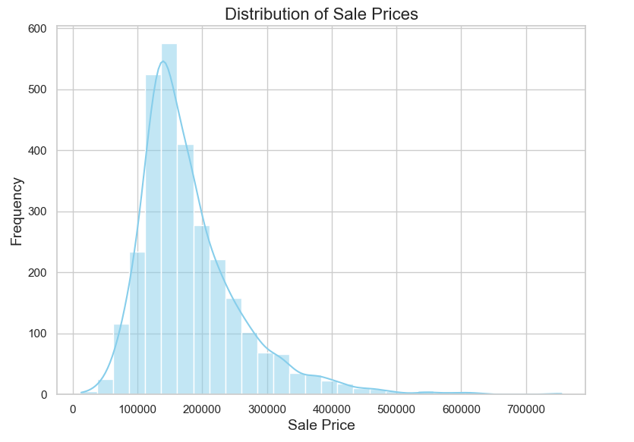
EDA : Distribution of Sale Price
05
Purpose:
to understand how home prices are distributed within the dataset
To understand the data transformation techniques for predictive modeling
Home sales typically follow a normal distribution with slight right skewness.
The usual price range falls between $100,000 and $200,000.
There is a highly competitive pricing approach.

Slide 7
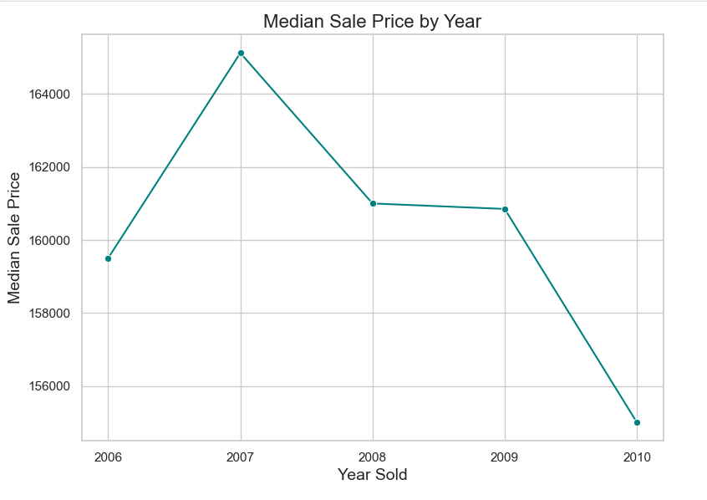
EDA: trend analysis
06
Purpose:
to understand how house prices have changed over different years.
to make data-driven predictions about where the market is heading.
A sharp decline in prices occurred between 2007 and 2008, and again from 2009 to 2010.
This could be attributed to the global recession that took place during these years.

Slide 8
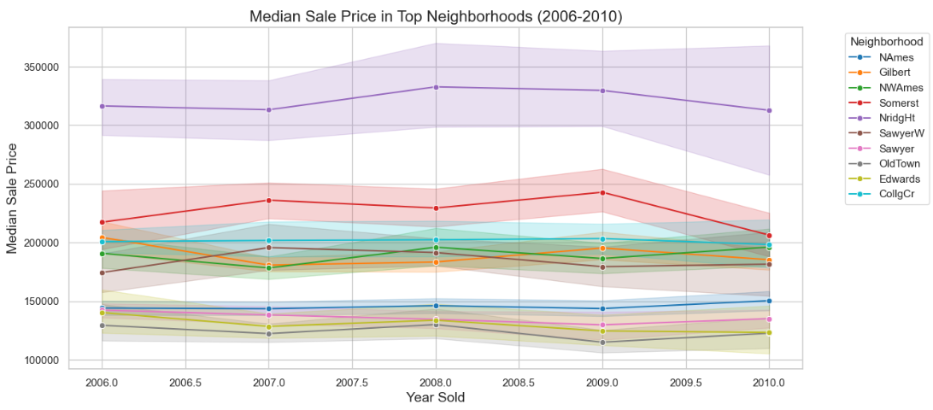
EDA: trend analysis in top 10 neighbourhoods
07
Purpose:
to see how median house prices vary across different neighbourhoods over time.
to compare the price trajectories and understand local market dynamics.
There was a decline in high-value houses, particularly between 2009 and 2010.
Conversely, low-value houses experienced an upward trend.

Slide 9
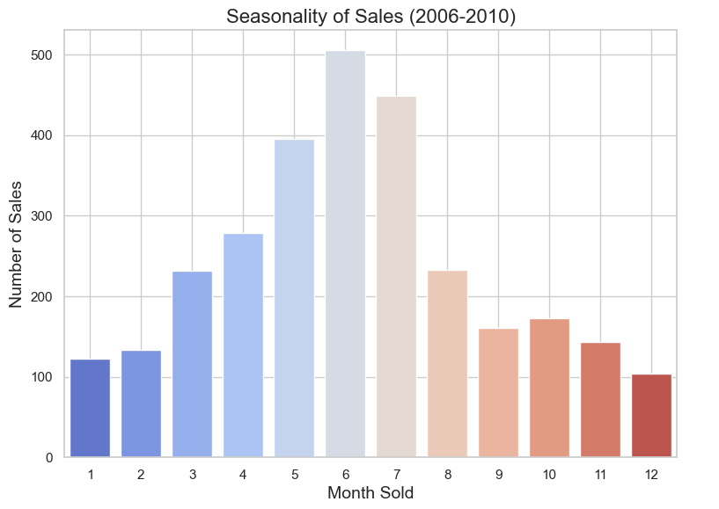
EDA: Seasonality of sales
08
Purpose:
to understand peak and slow seasons
to understand buyer behaviour.
June is the month with the highest activity, followed by July and May.
Real estate agents can modify their marketing strategies and advertisements based on this trend during the slower season.

Slide 10
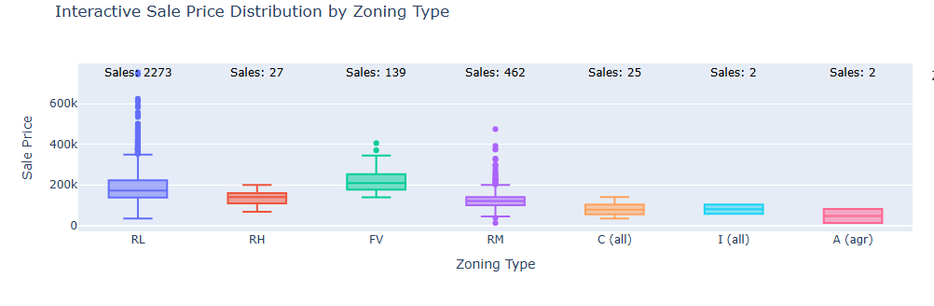
EDA: Sales distribution by zoning types
09
Purpose:
to analyse the distribution of sales prices across different zoning types.
The highest number of sales occur in the RL zone, featuring a median price of 172K.
FV is an upscale neighbourhood where the median house price exceeds 200K.
The RM area sees the second highest number of sales, with a median sales price of 120K.
RL: Residential in low densed area RH: Residential in low densed area
FV: Flood prone/Vulnerable area RM: Residentian in median densed area
C: Commercial area I: Industrial area
A: Agricultural area

Slide 11
Machine learning
10
Data ready
Model Preparation
Training
testing
MACHINE LEARNING, PREDECTIVE ANALYSIS

Slide 12
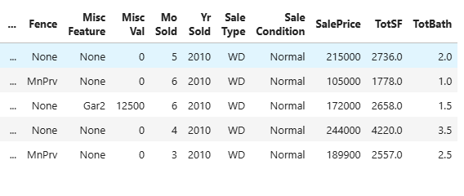
Creating new data frame
11
Purpose:
to compile similar data-total square footage of an apt including no of full bathrooms
Data ready for training and testing with

Slide 13
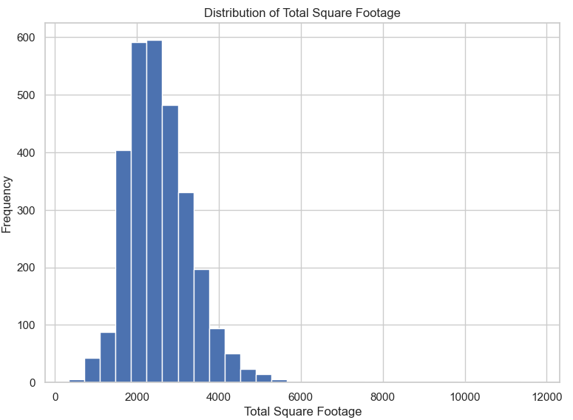
EDA: distribution of total square footage
12
Purpose:
to analyse the distribution of sales prices across different zoning types.
xxcxxxx

Slide 14
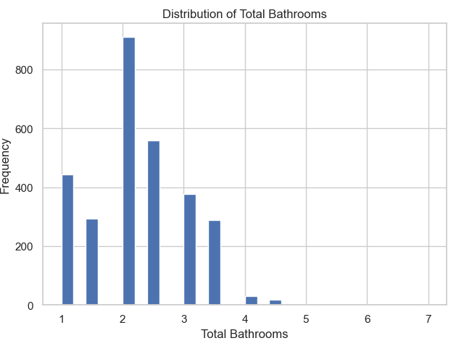
EDA: distribution of total bathrooms
13
Purpose:
to check correlation between house type and bathroom quantity
xxcxxxx

Slide 15
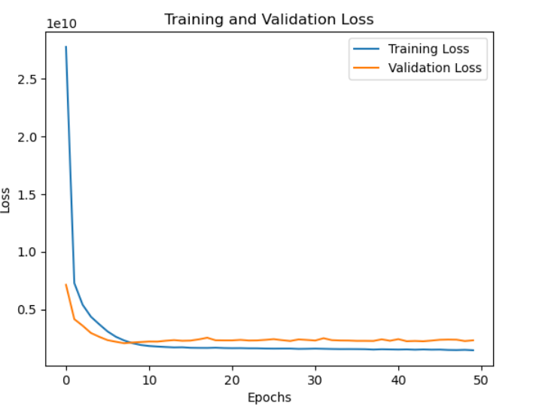
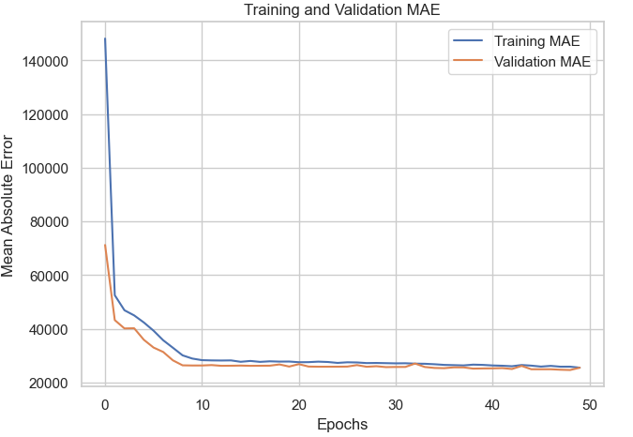
Testing Means of Absolute Error (MEA)
13
Purpose:
to evaluate the margin of error in the model's predictions. # Here shows that the model is making very good generalizations, matching very closely to the training data
Here shows that the model is making very good generalizations, matching very closely to the training data

Slide 16
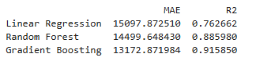
Regression testing
14
Purpose:
to further evaluate the model's quality and stability
Here shows that the model is making very good generalizations, matching very closely to the training data

Slide 17
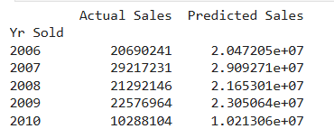
Regression testing
15
Purpose:
to further evaluate the model's quality and stability
Here shows that the model is making very good generalizations, matching very closely to the training data

Slide 18
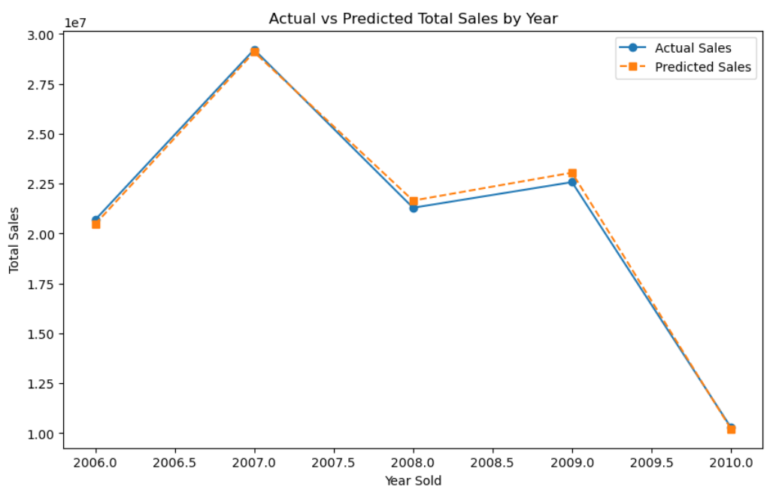
Actual vs predicted Sales by year
16
Purpose:
to further evaluate the model's quality and stability
Here shows that the model is making very good generalizations, matching very closely to the training data

Slide 19
Conclusion
16
Between 2007 and 2010, there was a noticeable decline in house prices in Ames, Iowa. Specifically, there was a sharp decline in prices between 2007 and 2008, and again from 2009 to 2010.
This trend can be attributed to the global recession that took place during these years1.
Additionally, high-value houses saw a decline, particularly between 2009 and 2010, while low-value houses experienced an upward trend.
Neural Network Model can perfectly predict Target price with an accuracy of almost 100%

Slide 20
Thank you

